Slide 1


CHHANAKYA
THE GLOBAL SCHOOL FOR INTELLECTUALS
ANNUAL REPORT
2023 - 24

Slide 2
CHHANAKYA THE GLOBAL SCHOOL FOR INTELLECTUALS
Chhanakya The Global School for Intellectuals is co-educational International School affiliated by Cambridge Assessment International Education established in 2017, with a view to offering world-class educational opportunities in the city of Palghar.
Chhanakya the Global school has focused on improving practical knowledge , developing skills by using activity based learning.

Slide 3
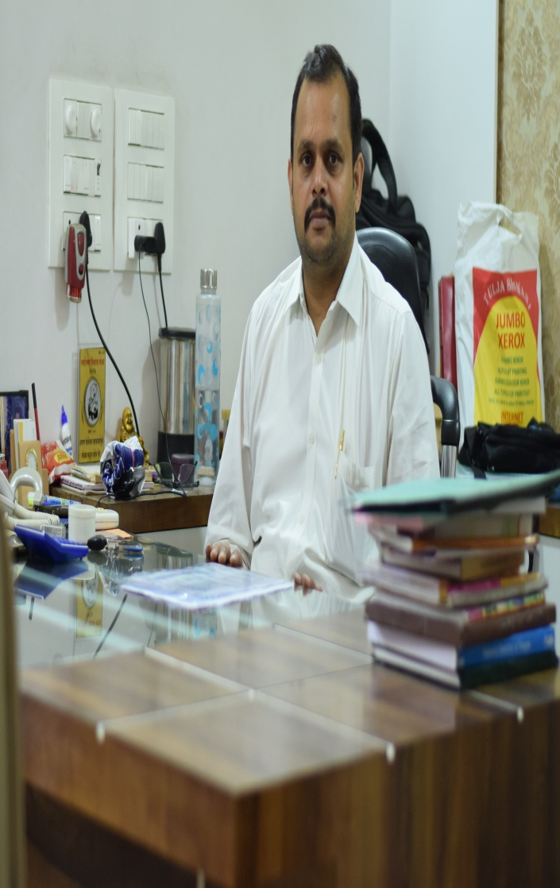
About Founder
Started on 23rd January 2017 by our Founder Chairman Shree Sandeep Tiwari sir, Rishabh Education.
Rishabh Education emerged with a concept of
“Bagless School”
with an idea of
“Nurturing Curiosity”
That promises to offer quality education, which as a parent you would have wished for your child.

Slide 4
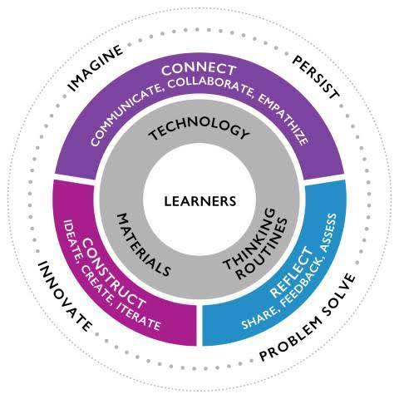
OUR FOCUS

Slide 5
ACADEMIC YEAR 2023 - 24

Slide 6

APRIL
APRIL

Slide 7

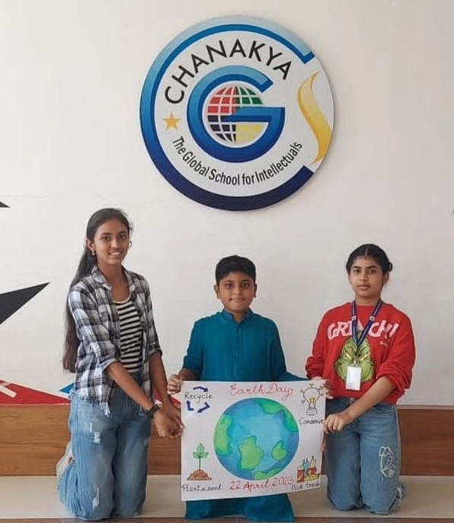

Slide 8
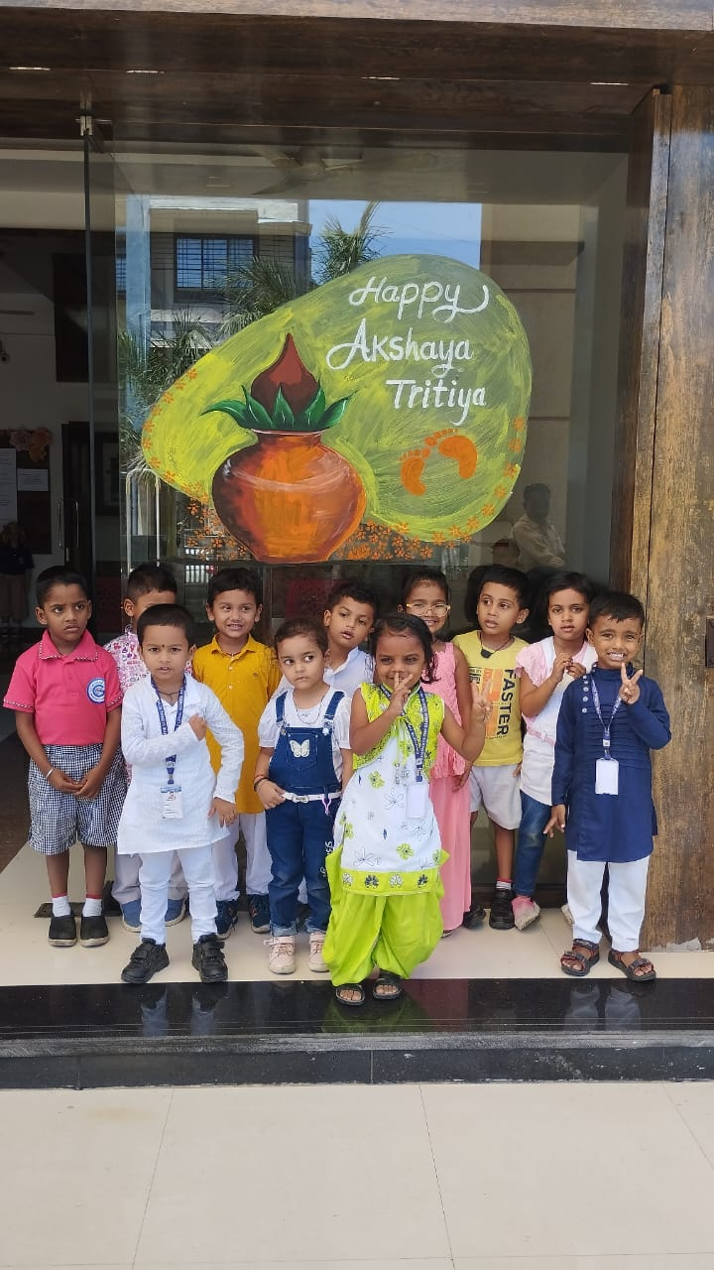
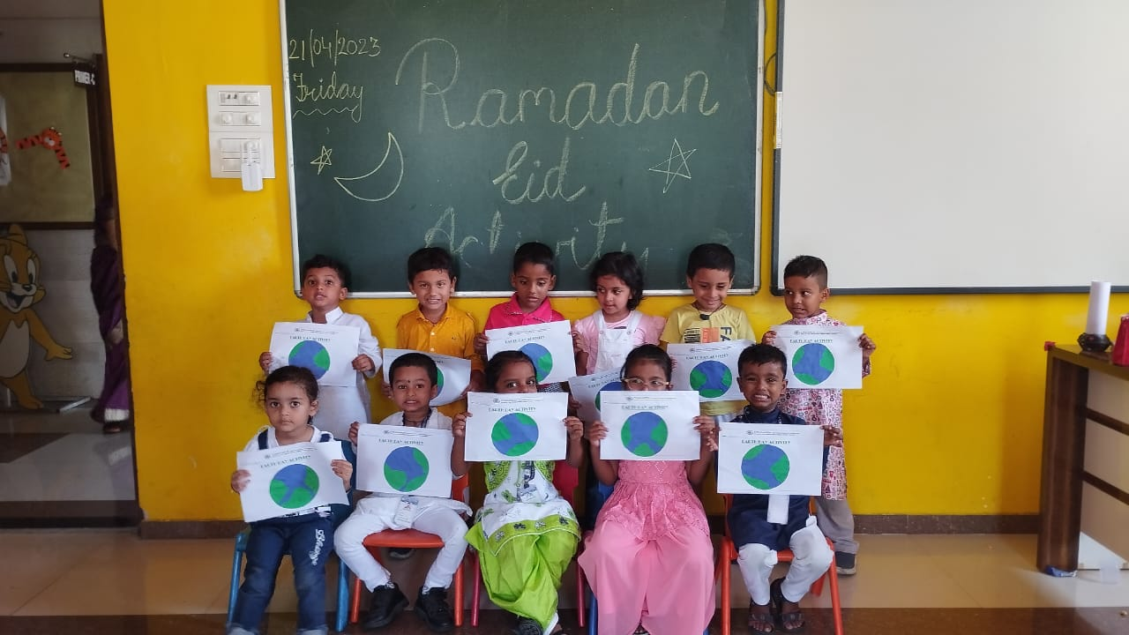
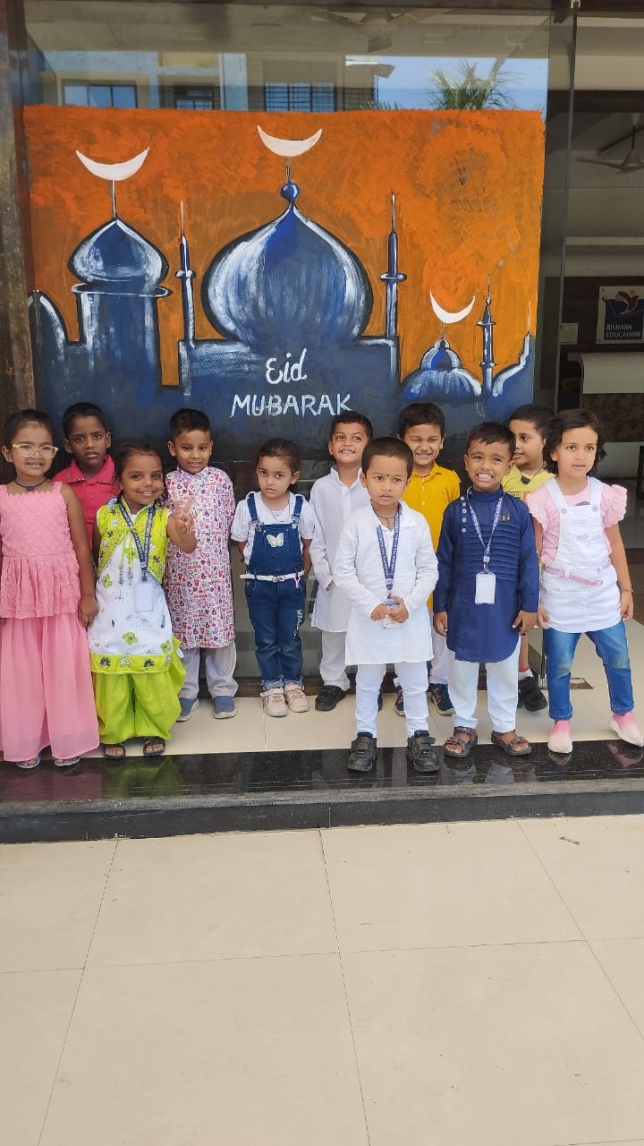
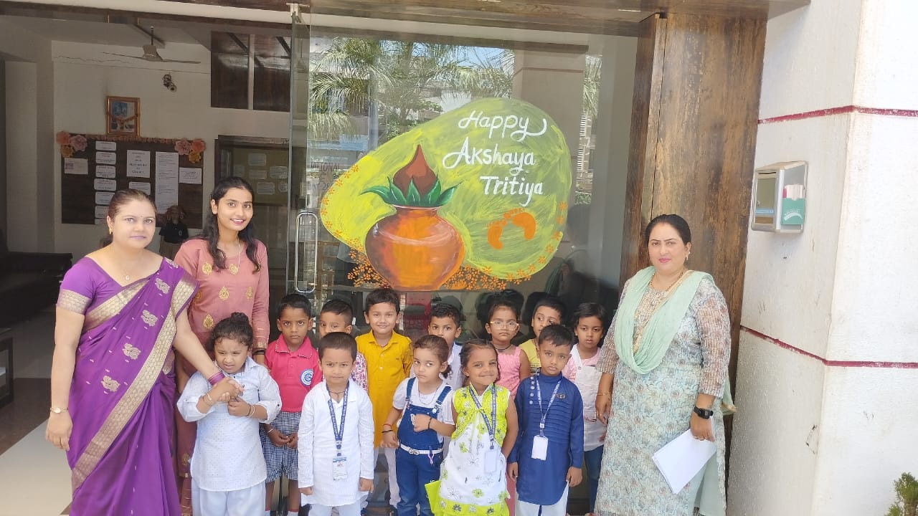

Slide 9

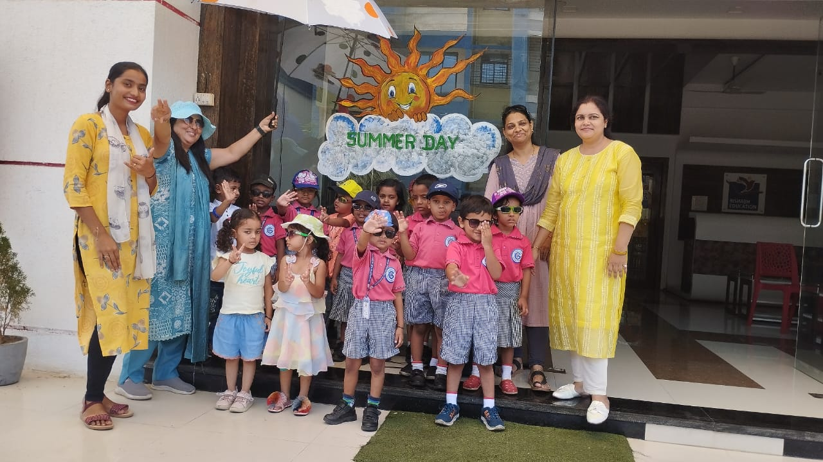
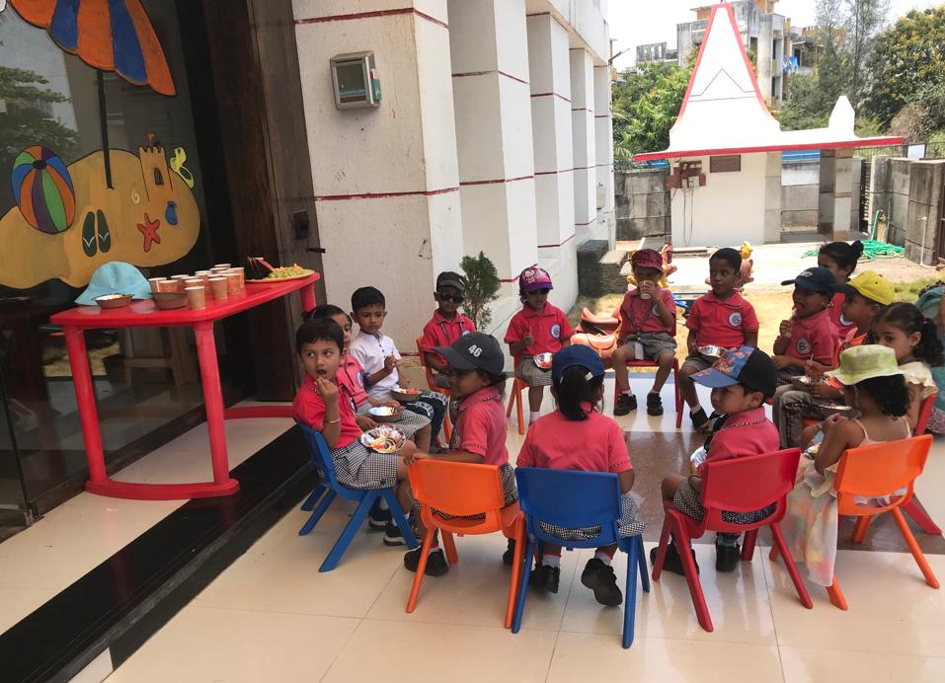
SUMMER DAY

Slide 10
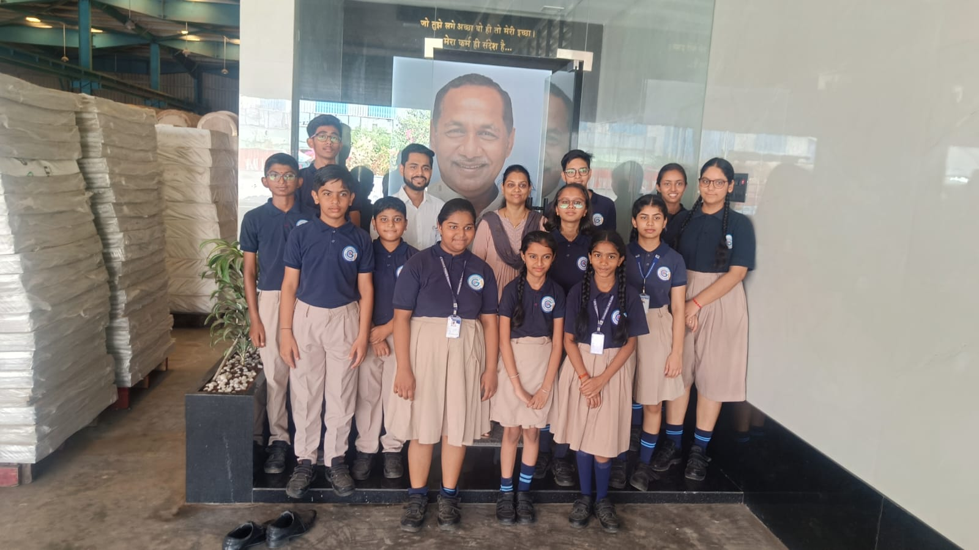
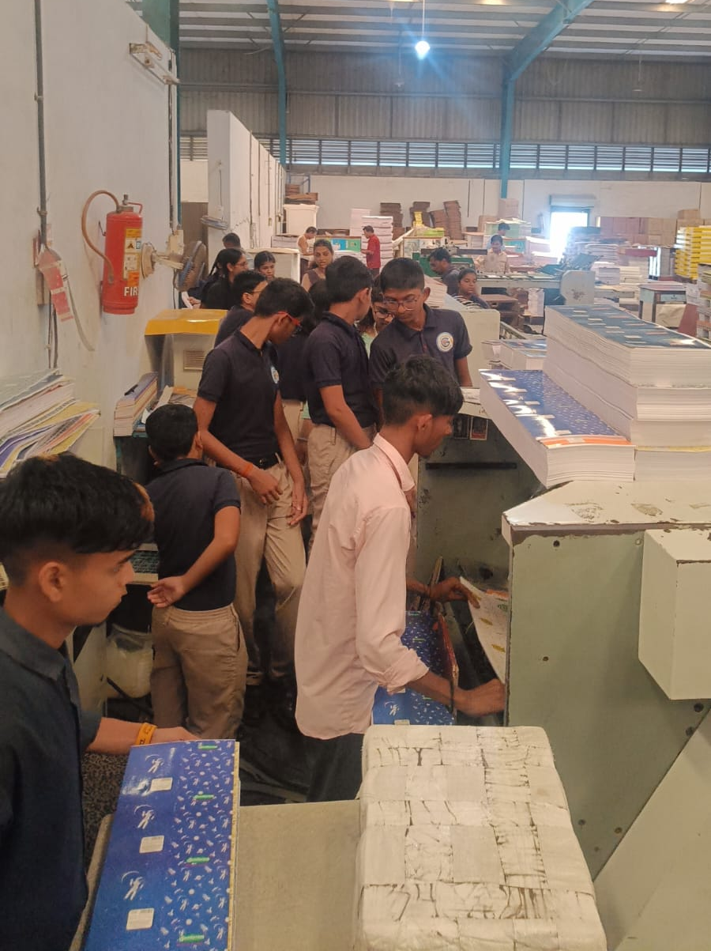
FIELD TRIP TO SUNDARAM BOOKS COMPANY

Slide 11
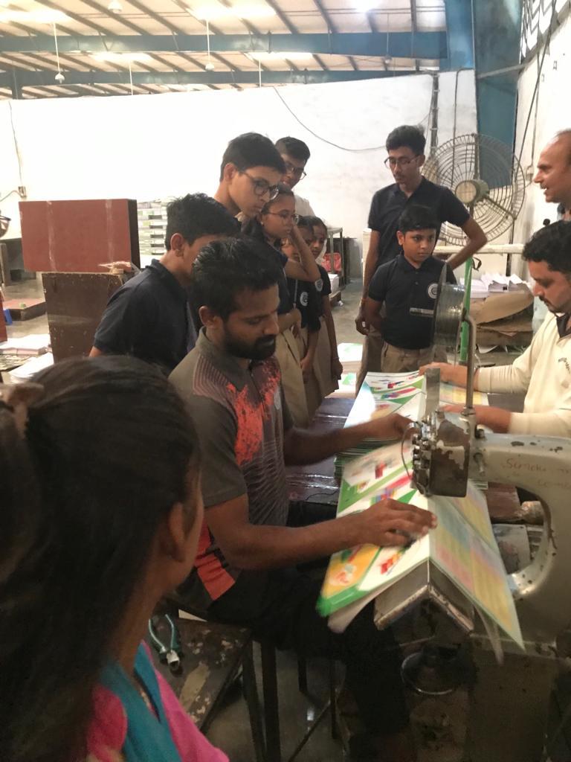
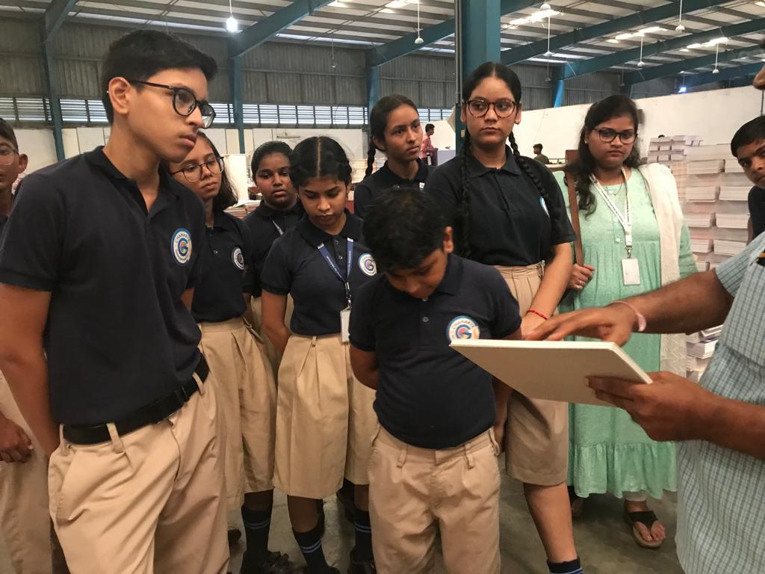

Slide 12


Slide 13
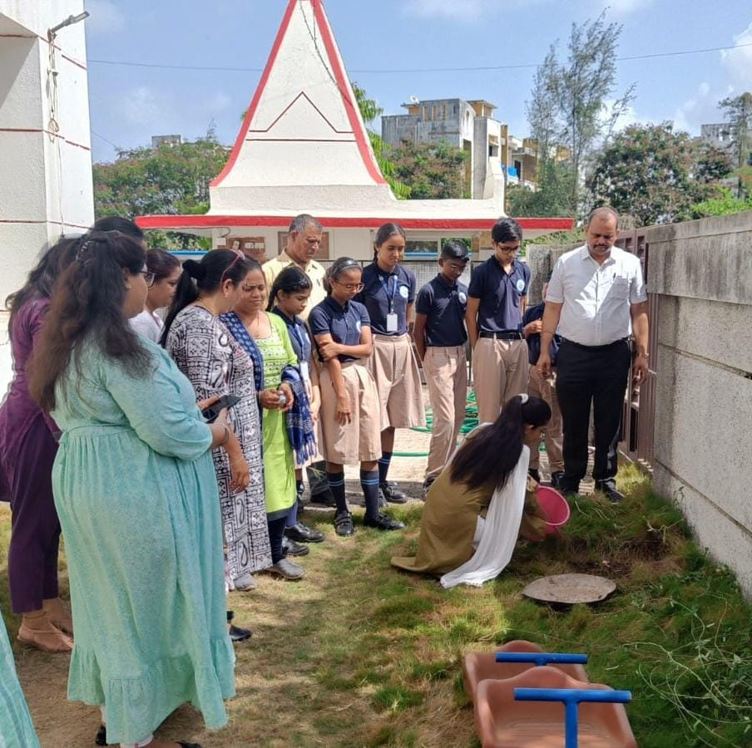
ENVIRONMENT DAY

Slide 14
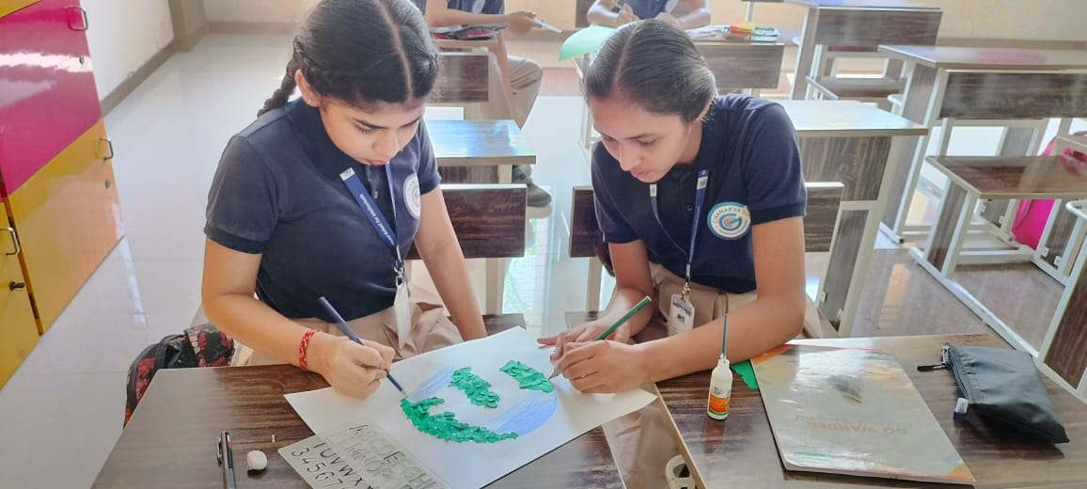
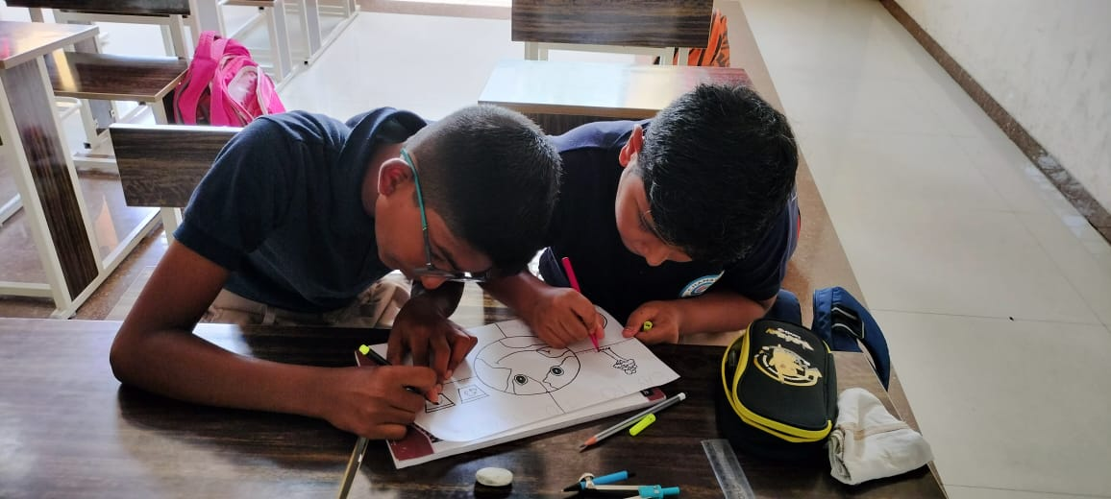
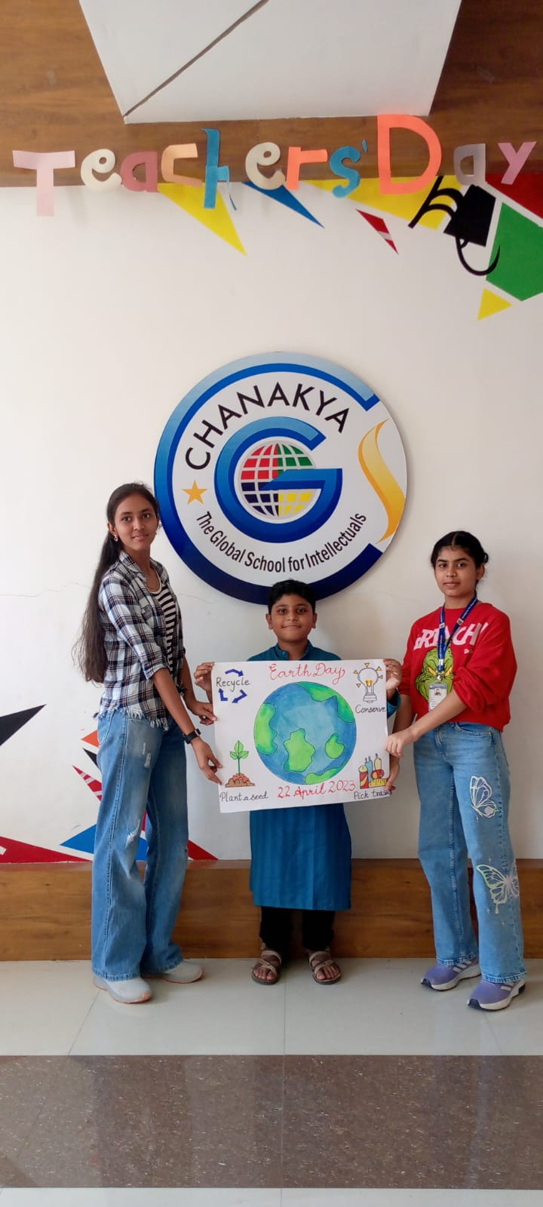

Slide 15
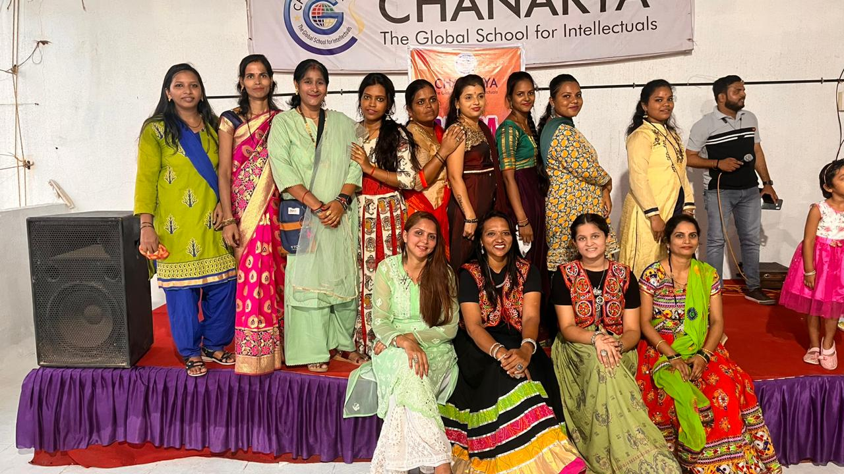
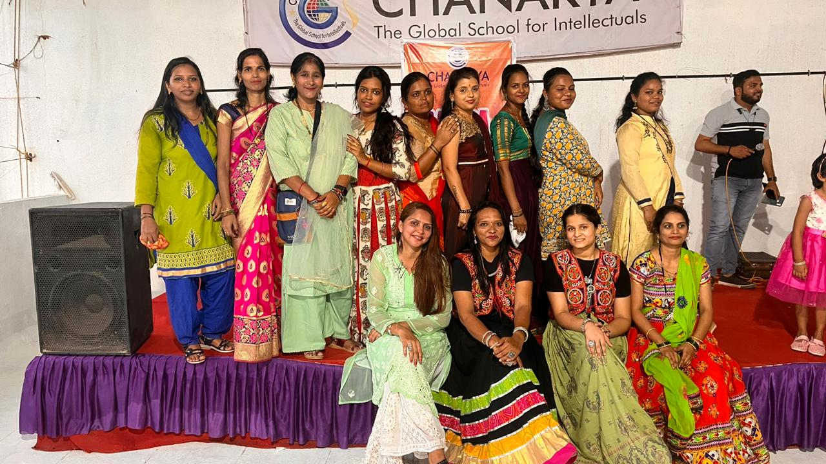
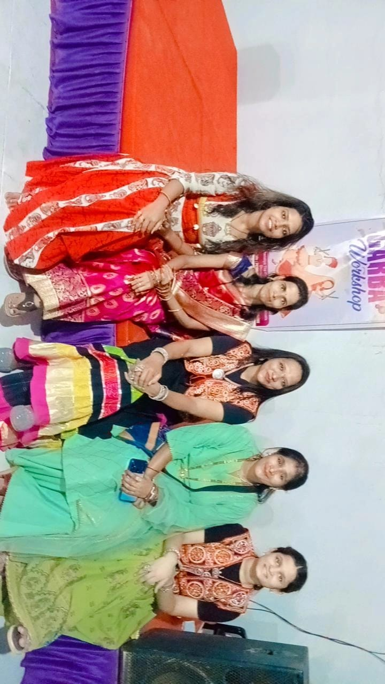
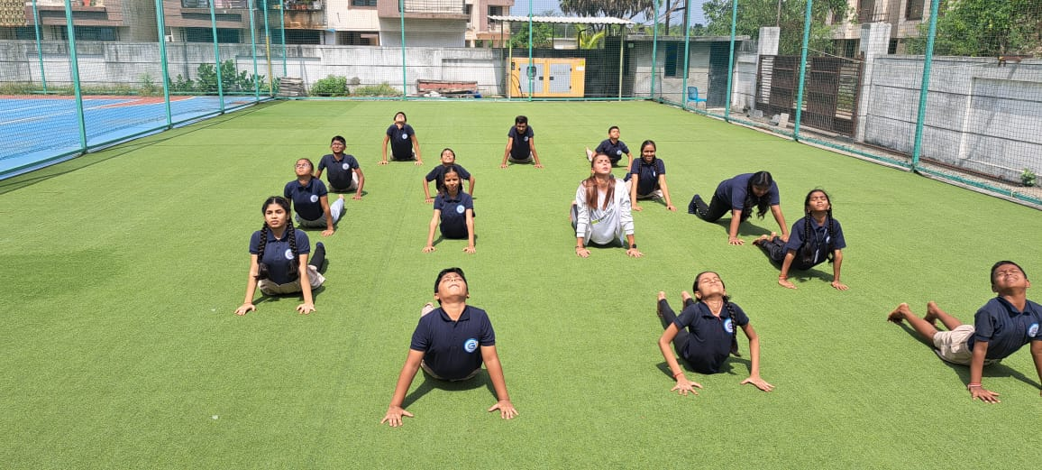
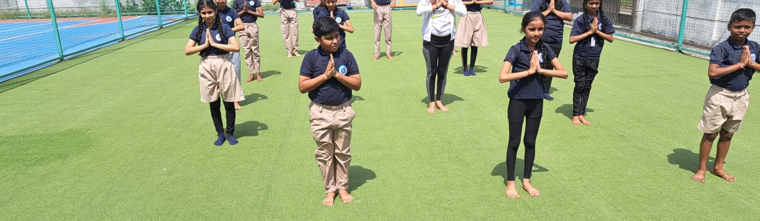
21st JUNE INTERNATIONAL YOGA DAY

Slide 16
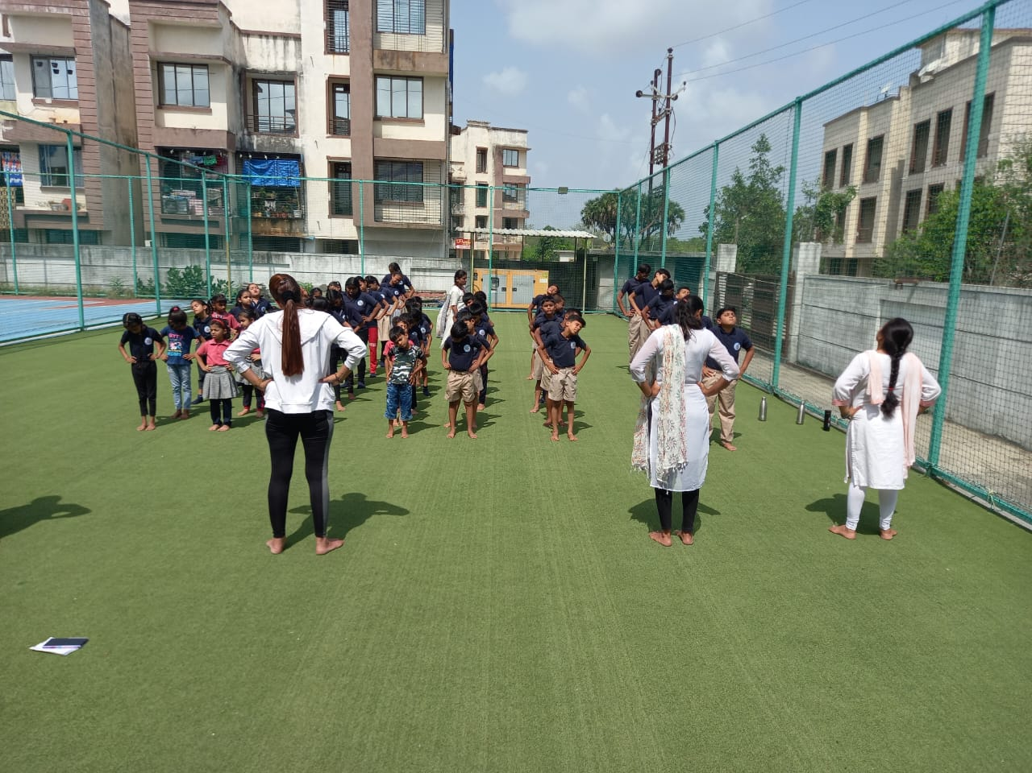

Slide 17
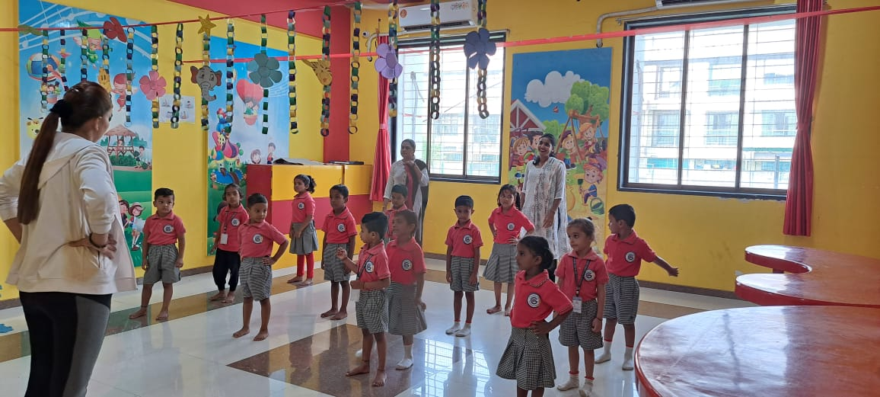
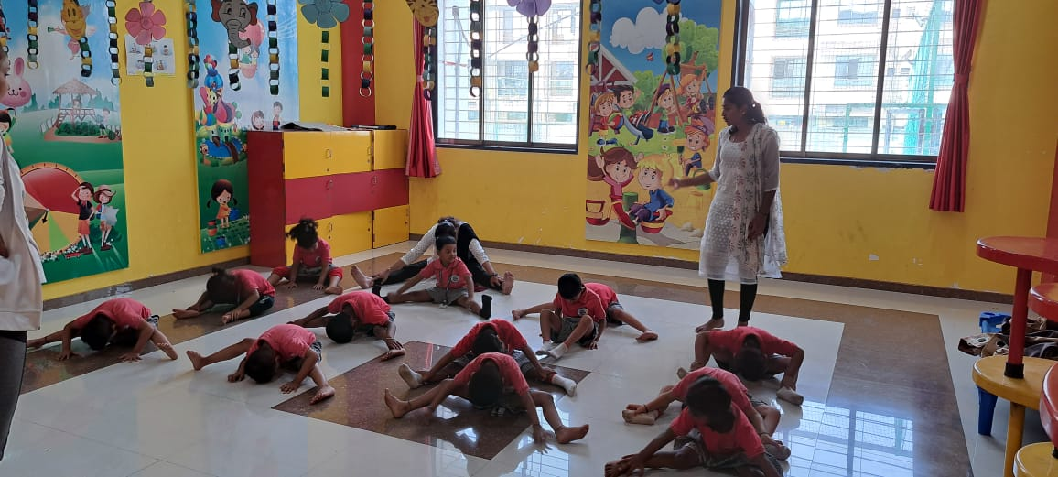

Slide 18
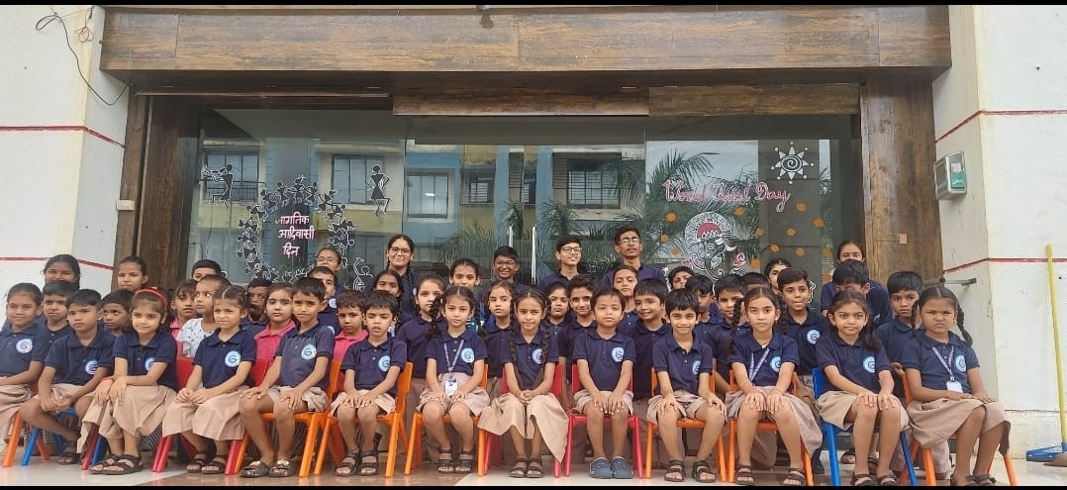
TRIBAL DAY

Slide 19


Slide 20

OPENING OF
OUR NEW VENTURE
8th JULY - 2023

Slide 21
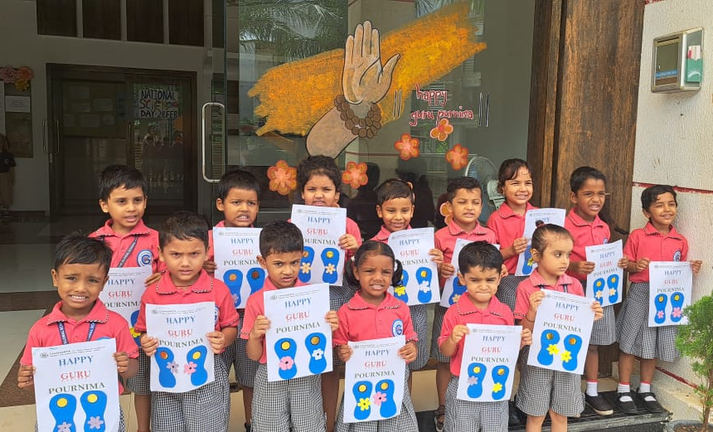
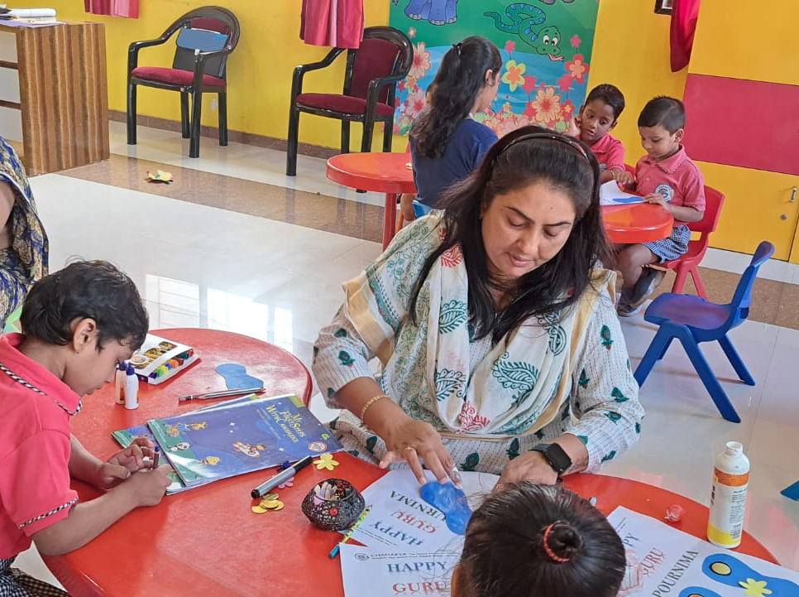
GURU PURNIMA

Slide 22
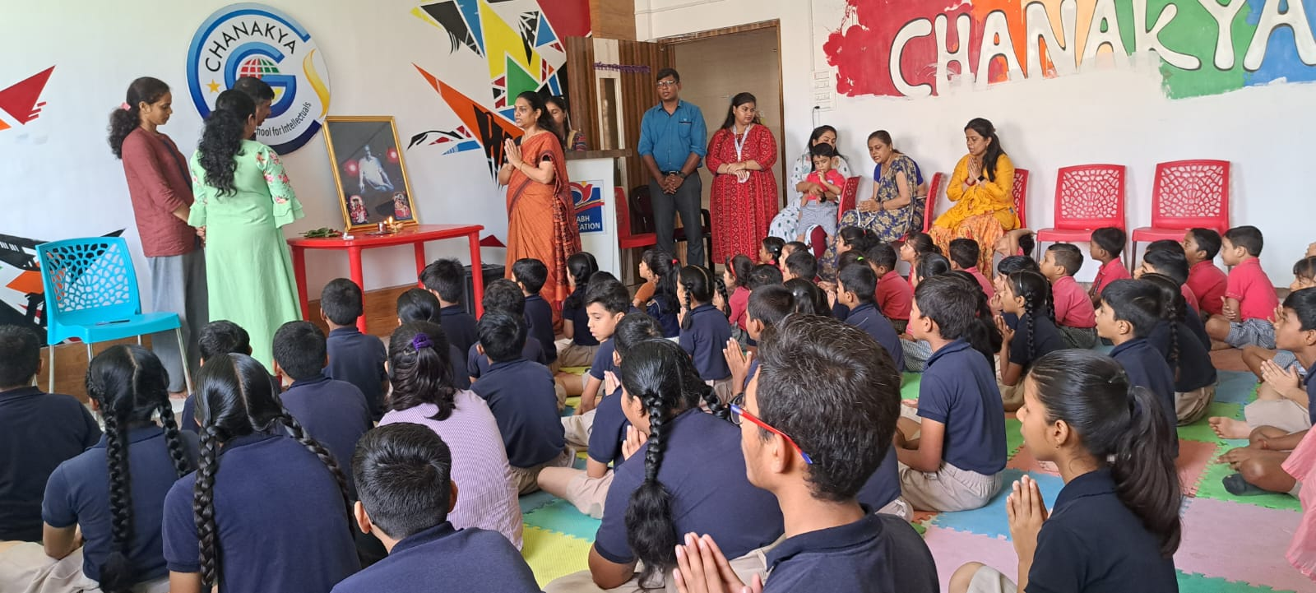

Slide 23
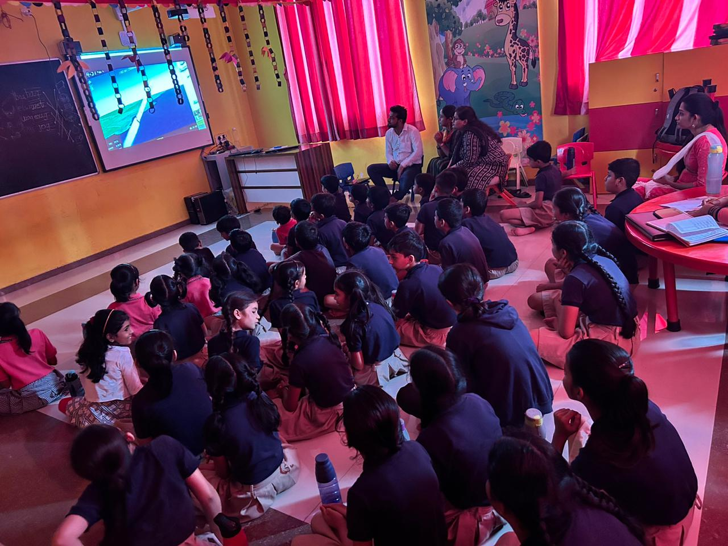
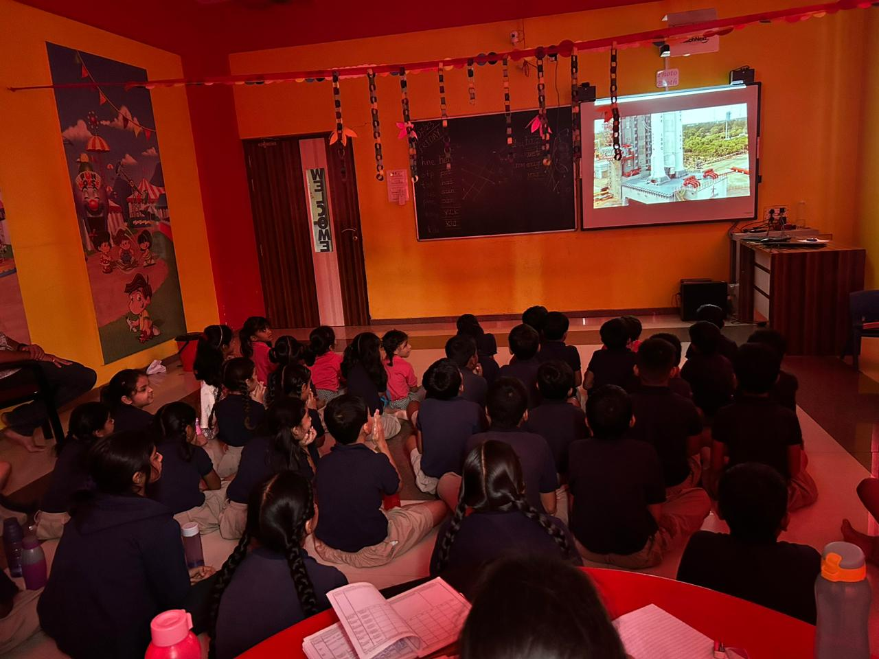
CHANDRAYAAN 3 LAUNCH

Slide 24


Slide 25
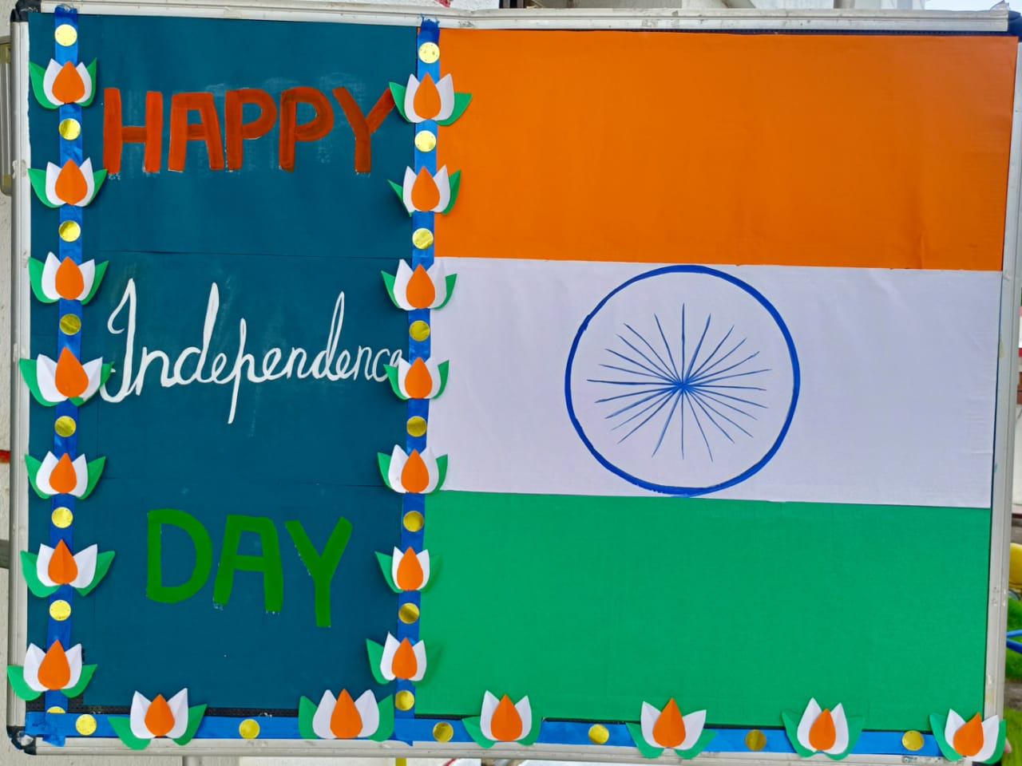
INDEPENDENCE DAY CELEBRATION

Slide 26
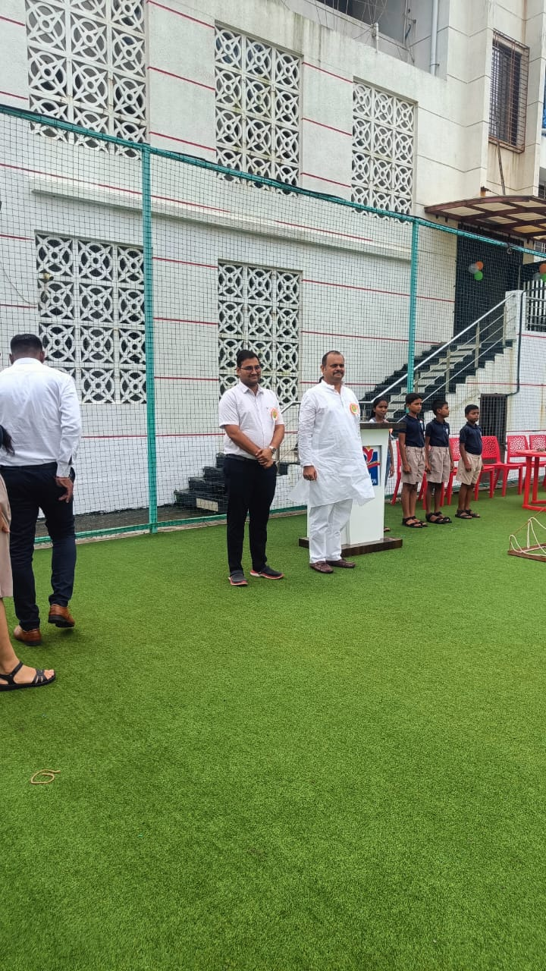
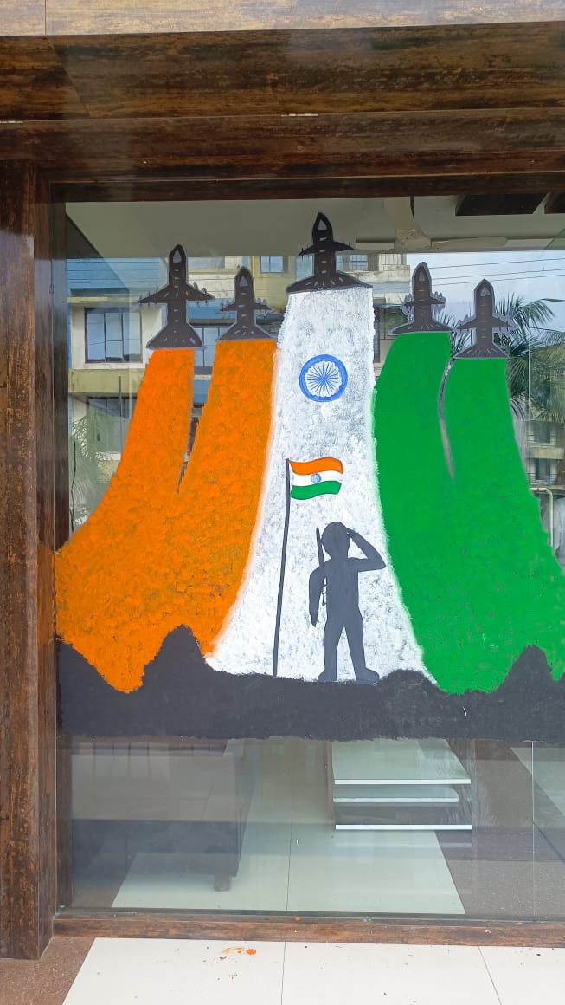

Slide 27
GARBA WORKSHOP FOR PARENTS

Slide 28
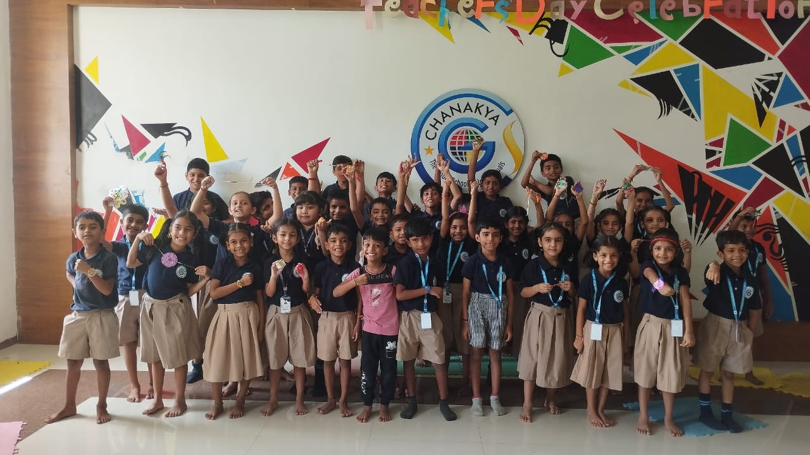
RAKSHA BANDHAN CELEBRATION

Slide 29


Slide 30
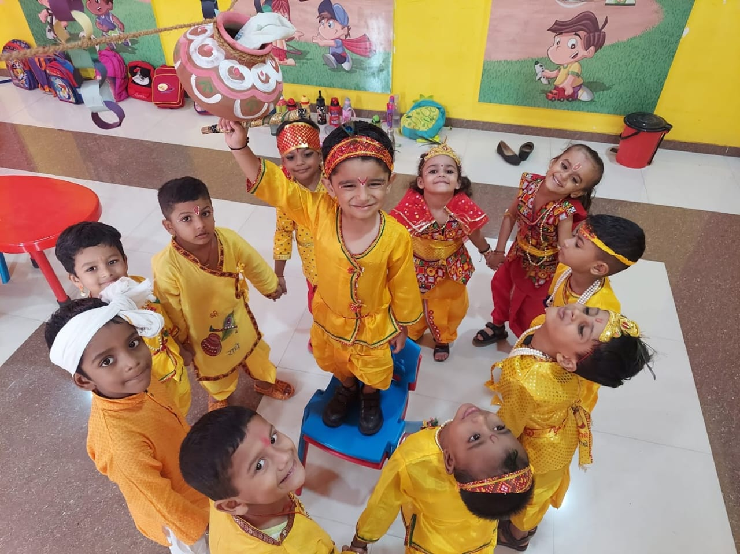
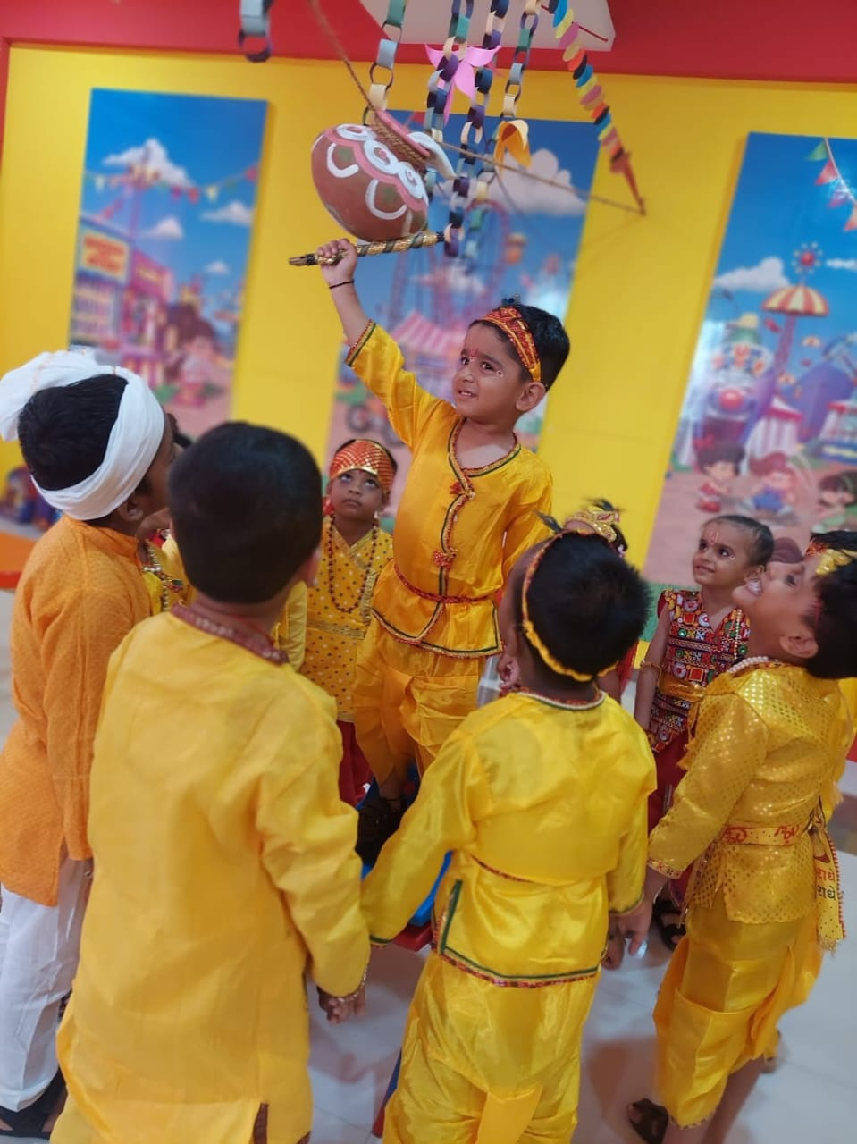
JANMASHTAMI

Slide 31
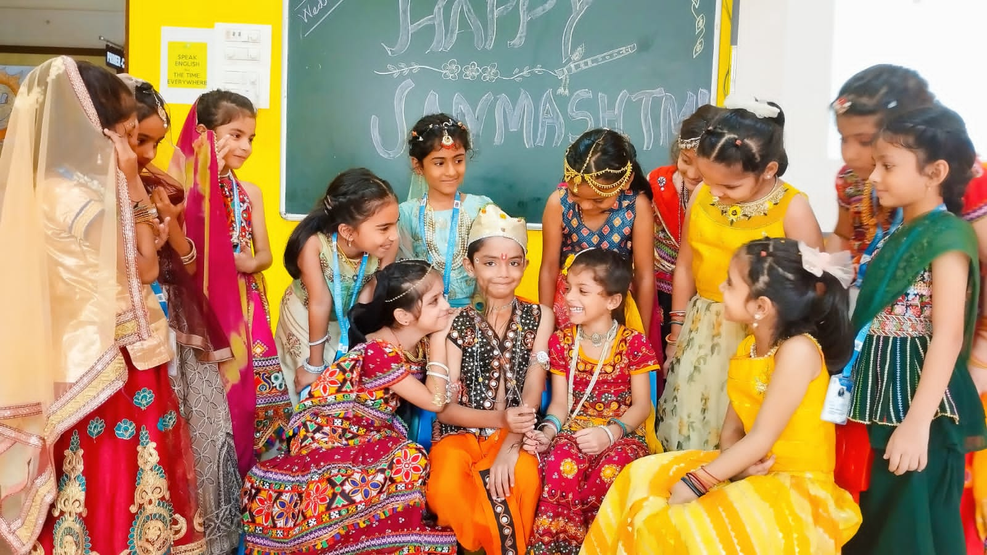
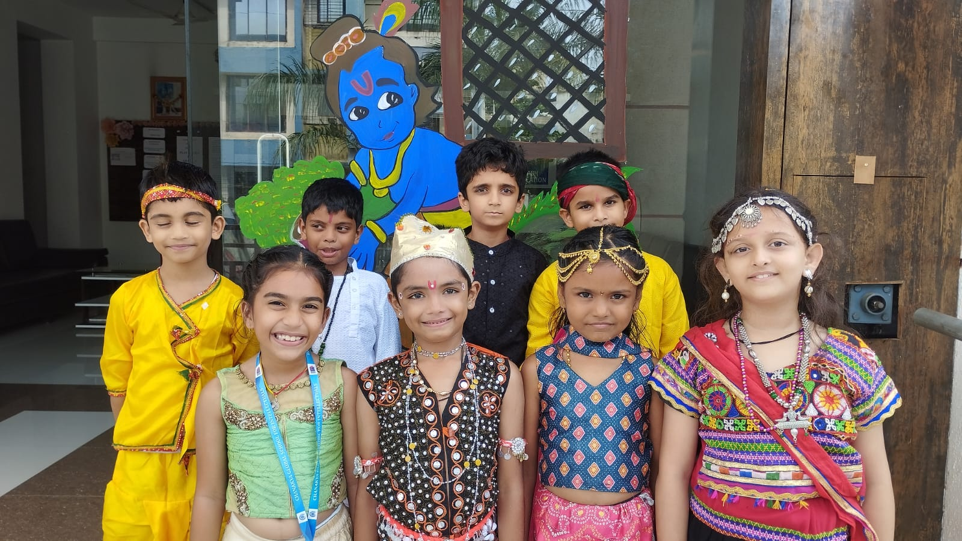

Slide 32
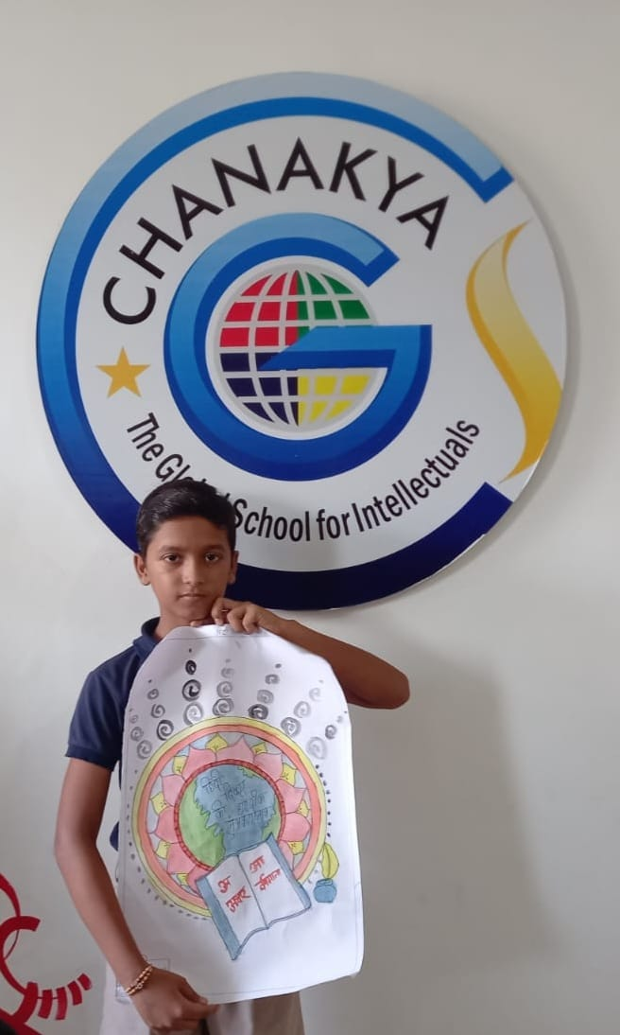
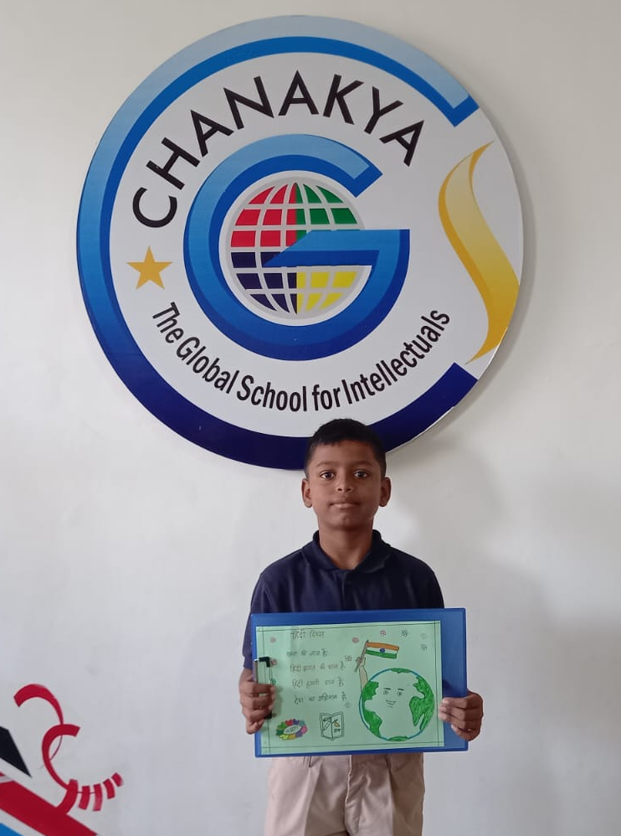
HINDI DIWAS

Slide 33
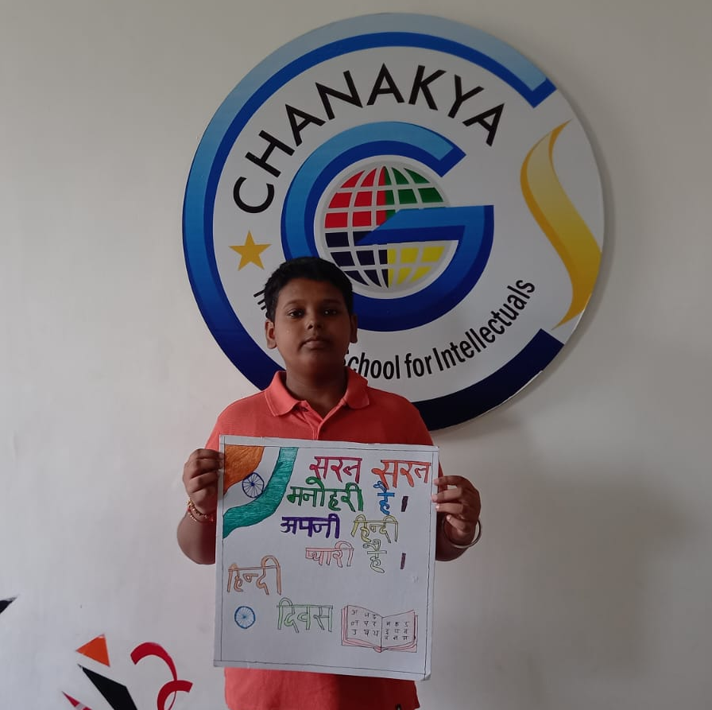
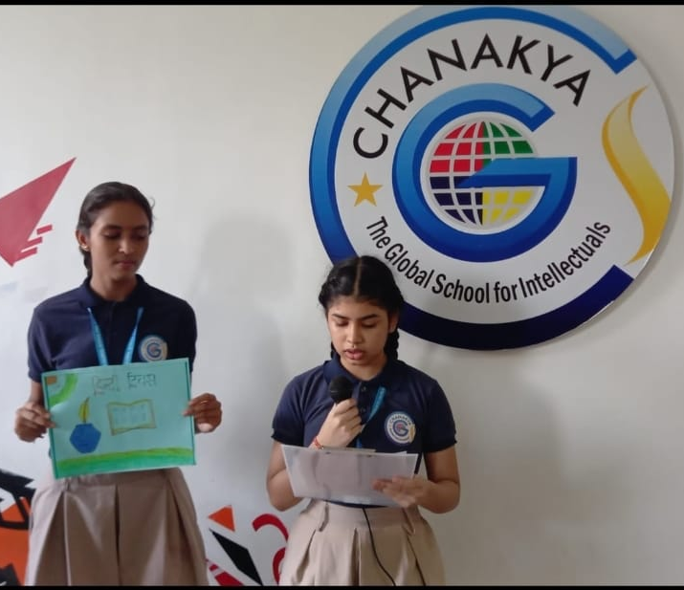

Slide 34
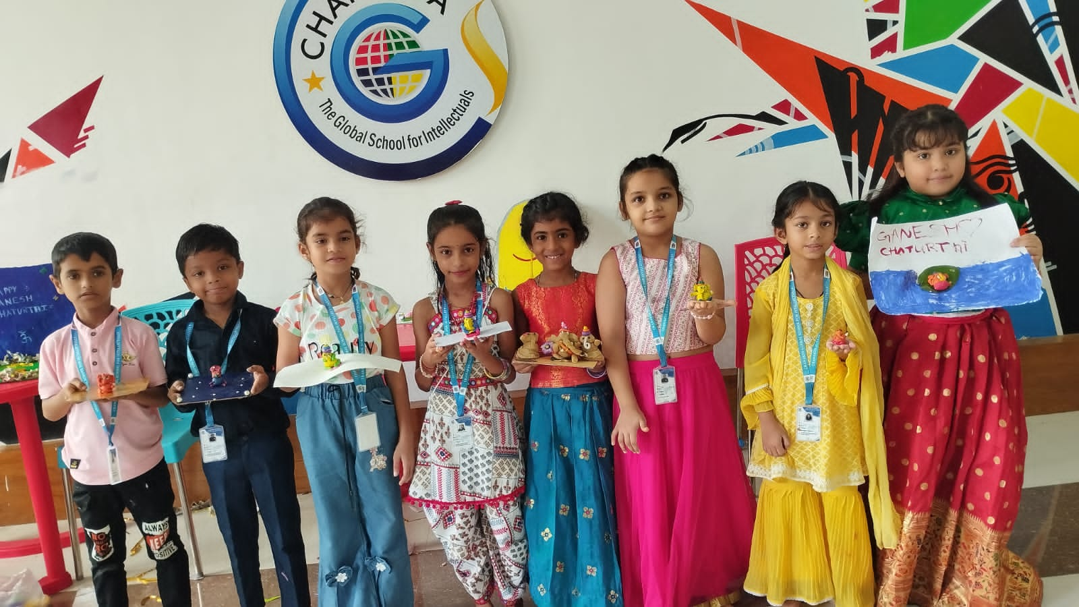
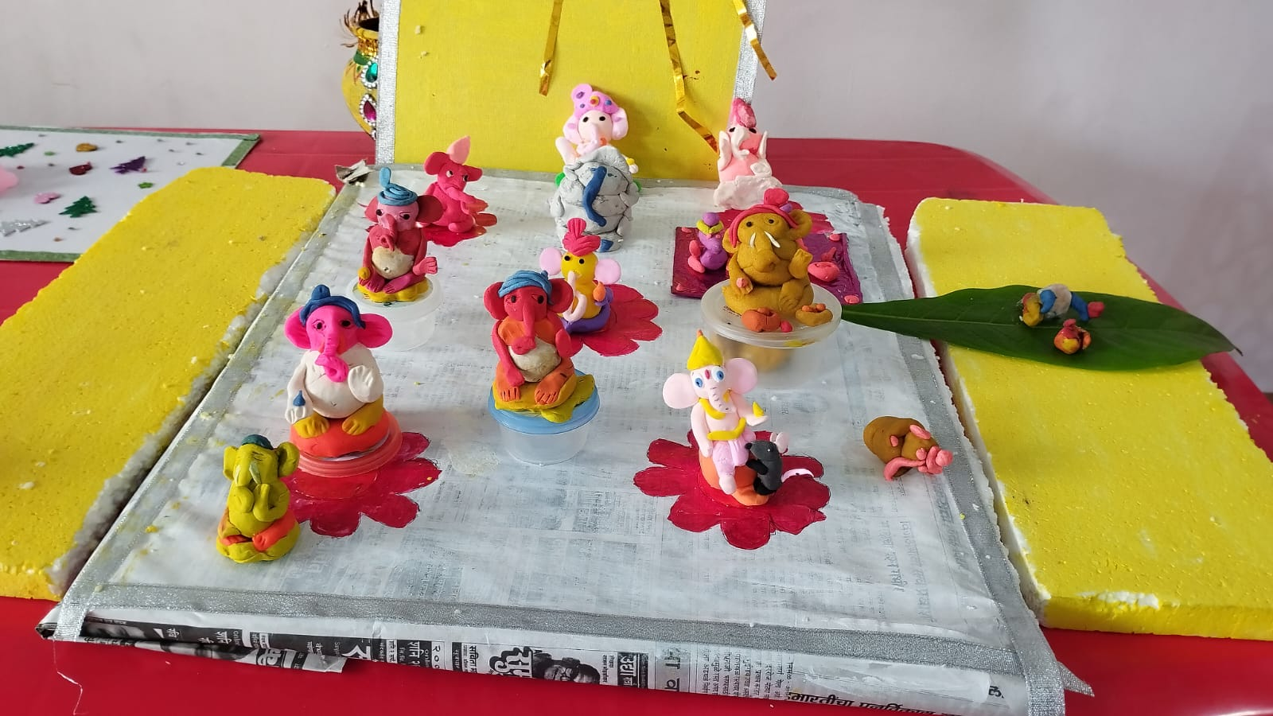
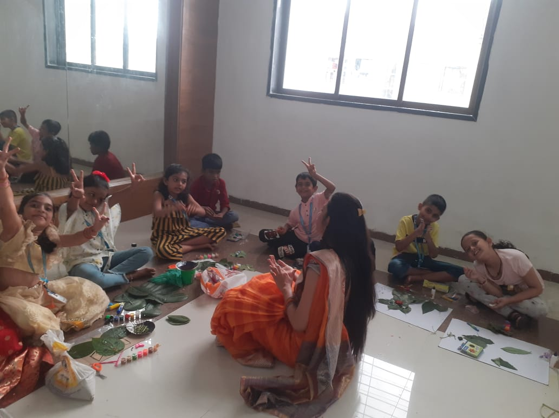
GANESH CHATURTHI

Slide 35


Slide 36
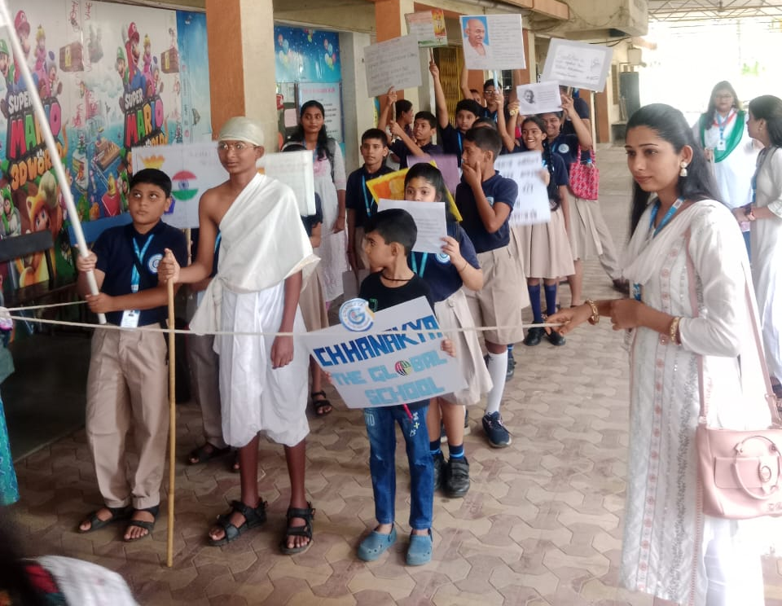
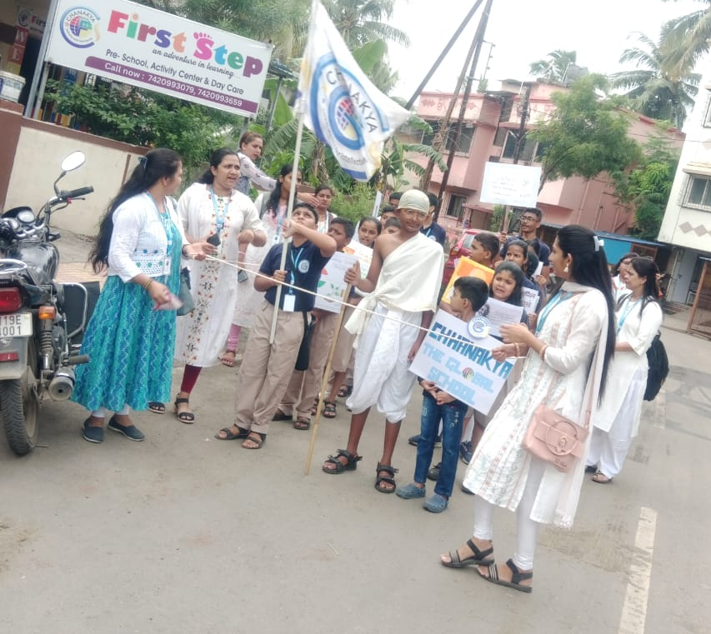
MAHATMA GANDHI JAYANTI RALLY

Slide 37
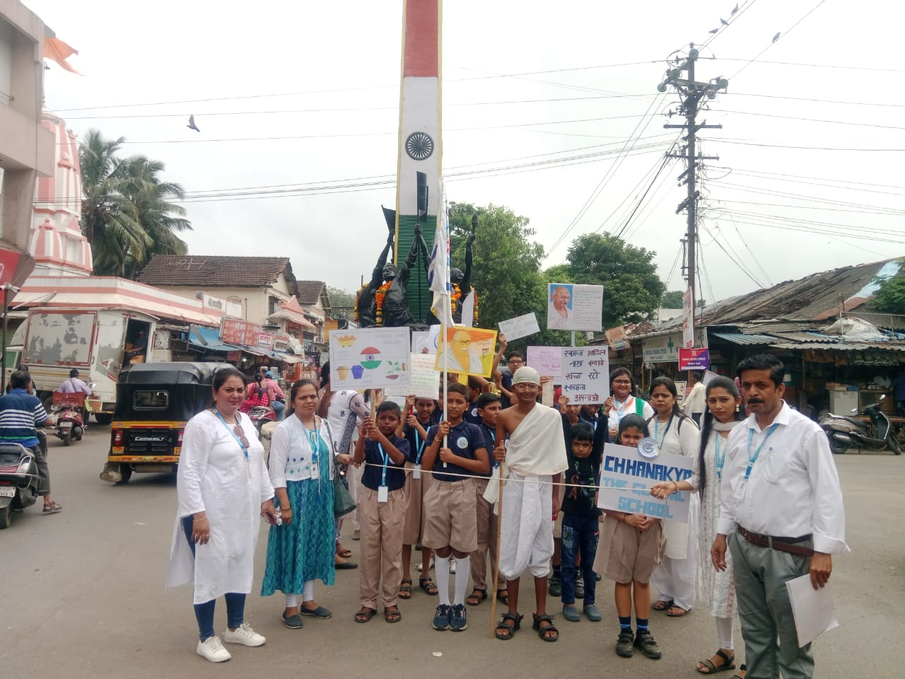
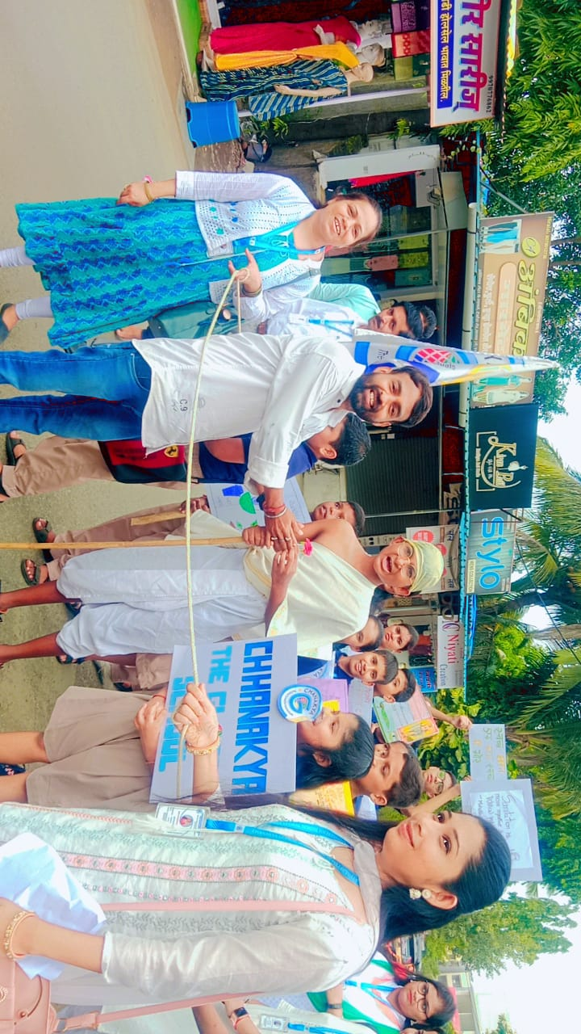


Slide 38


DUSSHERA CELEBRATION

Slide 39


HALLOWEENS DAY

Slide 40



Slide 41


Slide 42






DIWALI CELEBRATION

Slide 43





Slide 44


Slide 45


14th, 15th & 16th December
Annual Sports Day

Slide 46





Slide 47




Christmas Celebration
Christmas Celebration

Slide 48






Slide 49



Pre-Primary, Grade I & II

Slide 50



Slide 51

PRIMARY & SECONDARY PICNIC

Slide 52




Slide 53


Slide 54


Founder’s Day
Happy Birthday
Sir!

Slide 55




REPUBLIC DAY
      REPUBLIC DAY CELEBRATION

Slide 56






Slide 57


Slide 58

GRADE X BATCH 2023-24
Wishing you
SUCCESS in your
EXAMS!
May Good luck be in your favor
& your preparation bring
fantastic outcomes.

Slide 59


